Slide 1

IILM UNIVERSITY
Greater Noida
DATA SCIENCE MASTER
VIRTUAL INTERNSHIP
DATA SCIENCE MASTER
VIRTUAL INTERNSHIP
Internship Presentation
Internship Presentation
NAINIKA
Roll No. 2410030278 | B.Tech (Computer Science & Engineering)
Batch 2024–2028
April – June 2026

Slide 2
Internship at a Glance
02
A structured 8-week learning experience covering the complete data science workflow
8 Weeks
4 Learning Tracks
Duration of the virtual internship
Data Engineering, Machine Learning, Applications & Use Cases, Platform Administration
Apr–Jun 2026
End-to-End
Internship period
From data access and preparation to deployment-oriented concepts
Programme focus
The internship combined data preparation, machine learning, applications, integration, deployment and platform operations into a connected learning journey.
Data Science Master Virtual Internship | Nainika
IILM University, Greater Noida

Slide 3
Organisation & Programme Profile
03
The internship was completed through the AICTE–EduSkills virtual internship programme
EduSkills Academy
AICTE–EduSkills Programme
Siemens Data Science Master
An ISO-certified skill-development organisation working under the theme “Nation Building Through Skills.”
A structured virtual internship with learning modules, weekly assessments, assignments and a final assessment.
A practical learning pathway built around the RapidMiner (Altair) ecosystem and industry-oriented analytics skills.
Academic context: B.Tech in Computer Science & Engineering | IILM University, Greater Noida
Data Science Master Virtual Internship | Nainika
IILM University, Greater Noida

Slide 4
Problem Statement
04
The challenge of turning diverse raw data into reliable analytical solutions
Modern organisations collect data from files, databases, software applications, web services and distributed platforms.
Data Quality Challenges
Model-to-Production Gap
Operational Challenges
Data can be incomplete, inconsistent, unstructured or frequently changing, making reliable analysis difficult.
A model must be evaluated, documented, reproduced and integrated before it can create practical value.
Deployment, execution management, scheduling and platform administration are also required in real analytical workflows.
Internship response → build a complete understanding of how raw data is transformed into dependable, deployable analytics.
Data Science Master Virtual Internship | Nainika
IILM University, Greater Noida

Slide 5
Project Objectives
05
The internship objectives combined core technical learning with practical and production-oriented skills
1
Develop practical knowledge of data access, cleansing, transformation and preparation workflows.
2
Learn advanced data-engineering techniques including text processing, macros, loops and Web API interaction.
3
Understand classification, feature engineering, parameter optimisation and model evaluation.
4
Study time-series forecasting and the use of Python and R within analytical workflows.
5
Use CRISP-DM to organise a data-science project from business understanding through deployment.
6
Gain awareness of web applications, AI Hub administration, scheduling and real-time scoring.
Overall objective: connect data engineering, machine learning, applications and platform operations into one end-to-end understanding of data science.
Data Science Master Virtual Internship | Nainika
IILM University, Greater Noida

Slide 6
Scope & Learning Tracks
06
The programme covered transferable skills across the analytical lifecycle rather than one dataset or algorithm
Data Engineering
Machine Learning
Data access, cleansing, transformation, text processing, macros, loops and Web APIs
Classification, feature engineering, parameter optimisation and time-series forecasting
Applications & Use Cases
Platform Administration
CRISP-DM, evaluation, deployment and practical web-application concepts
AI Hub, projects, jobs, queues, schedules, deployment and real-time scoring
Professional Level
Master Level
Together, these tracks connected model development with the infrastructure and processes needed to operate analytical workflows.
Data Science Master Virtual Internship | Nainika
IILM University, Greater Noida

Slide 7
Technologies & Tools
07
Main technologies, platforms and methodologies covered during the internship
Altair AI Studio / RapidMiner
Altair AI Hub
Python
Visual data preparation, ETL-style workflows and machine-learning process development
Projects, executions, jobs, queues, schedules and deployment-oriented administration
Integration of external data-science code and packages into analytical workflows
R
Web APIs
Text Processing
Integration of statistical and analytical models where required
Connecting workflows with external data and services
Preparing and transforming unstructured textual information
CRISP-DM
Business understanding, data preparation, modelling, evaluation and deployment.
Data Science Master Virtual Internship | Nainika
IILM University, Greater Noida

Slide 8
End-to-End System Architecture
08
Conceptual workflow representing the layers covered throughout the internship
DATA SOURCES
DATA ENGINEERING
MACHINE LEARNING
INTEGRATION
APPLICATIONS
DEPLOYMENT
ADMINISTRATION
Files
Databases
Web APIs
›
Access
Cleanse
Transform
›
Features
Classification
Parameter Tuning
›
Python
R
Specialised Models
›
CRISP-DM
Use Cases
Evaluation
›
Web Apps
AI Hub
Scheduling
›
Projects
Jobs & Queues
Real-Time Scoring
The architecture links data acquisition and preparation with modelling, integration, application, deployment and managed execution.
Data Science Master Virtual Internship | Nainika
IILM University, Greater Noida

Slide 9
Methodology
09
Progressive, assessment-driven learning from data access to platform operations
01
Data Understanding & Access
02
Data Preparation
03
Advanced Data Engineering
04
Model Development
Identify sources and understand access to structured and external data.
Clean, transform and organise information for dependable analytical use.
Use text processing, macros, loops and Web APIs to build flexible workflows.
Study classification and other machine-learning processes using prepared data.
05
Feature Engineering & Optimisation
06
Advanced Analytics
07
Applications & Use Cases
08
Platform Operations
Improve model inputs and tune parameters in a systematic way.
Explore time-series forecasting and integration with Python and R.
Structure projects with CRISP-DM while considering evaluation and deployment.
Understand AI Hub administration, deployment packages and real-time scoring.
Learning progression: Foundation → Advanced Processing → Integration → Deployment → Operations
Data Science Master Virtual Internship | Nainika
IILM University, Greater Noida

Slide 10
Key Learning Modules
10
Four major learning areas that shaped the internship experience
Data Engineering
Machine Learning
Professional: data access, cleansing and workflow construction.
Master: text processing, macros, loops and Web APIs.
Professional: classification and core modelling.
Master: feature engineering, parameter optimisation, forecasting and Python/R integration.
Applications & Use Cases
Platform Administration
Used CRISP-DM to organise data-science work and connect modelling with evaluation, deployment and practical applications.
Covered AI Hub projects, jobs, queues, execution environments, schedules, access management and real-time scoring.
Learning progression: foundation → advanced processing → integration → deployment → operations
Data Science Master Virtual Internship | Nainika
IILM University, Greater Noida

Slide 11
Expected Outcomes
11
Capabilities developed through the internship learning and assessment process
✓
Explain a complete data workflow from source-data collection to analytical results.
✓
Apply knowledge of data cleaning, transformation and preparation techniques.
✓
Understand text processing, macros, loops and Web API integration.
✓
Use classification, feature engineering and parameter-tuning concepts.
✓
Recognise time-series forecasting and combined Python/R workflows.
✓
Apply CRISP-DM as a systematic framework for data-science projects.
✓
Understand deployment, web applications and real-time scoring.
✓
Appreciate collaborative and administrative requirements in enterprise analytics.
Data Science Master Virtual Internship | Nainika
IILM University, Greater Noida

Slide 12
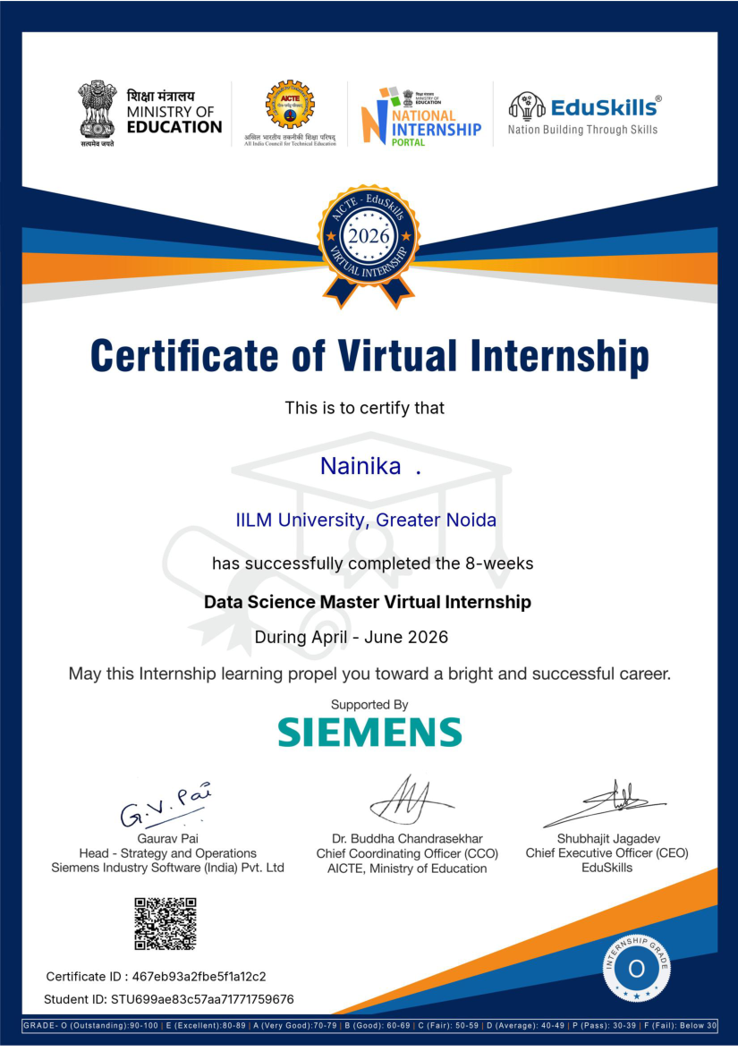
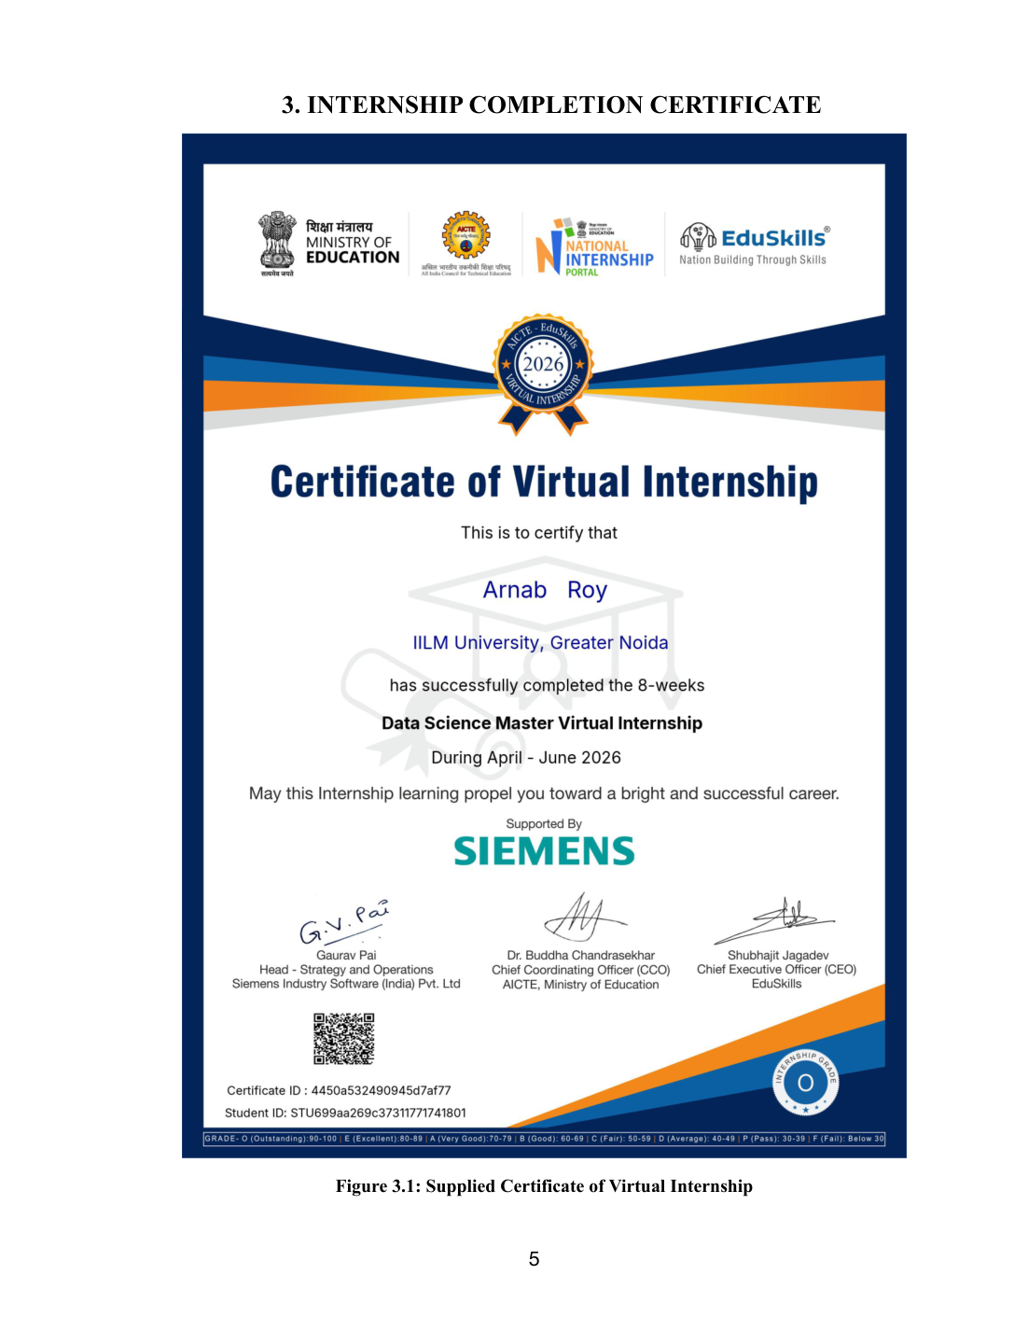
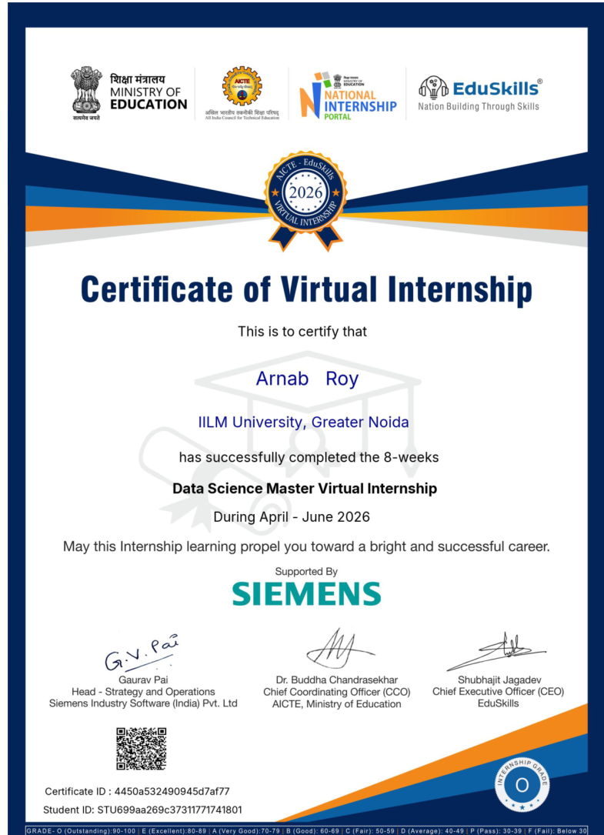
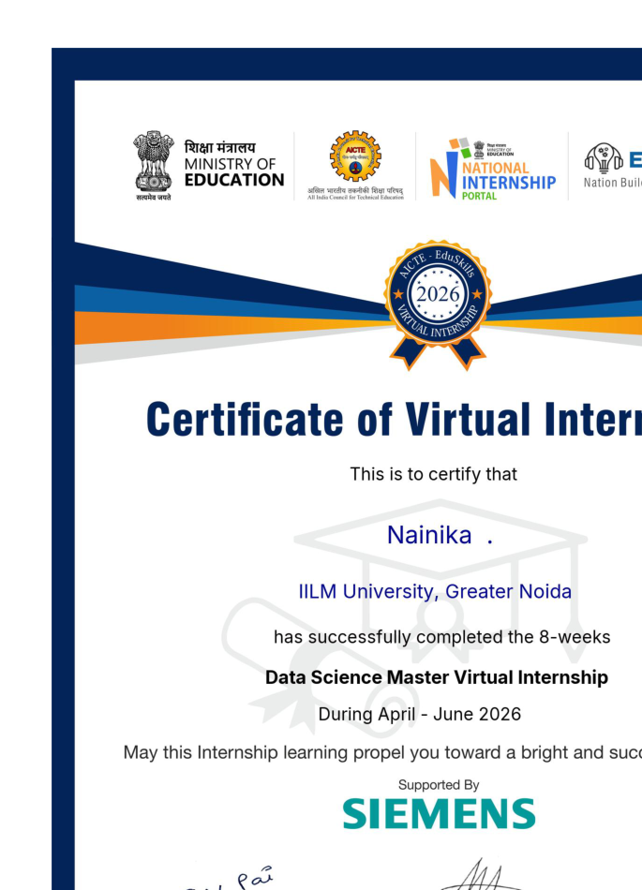
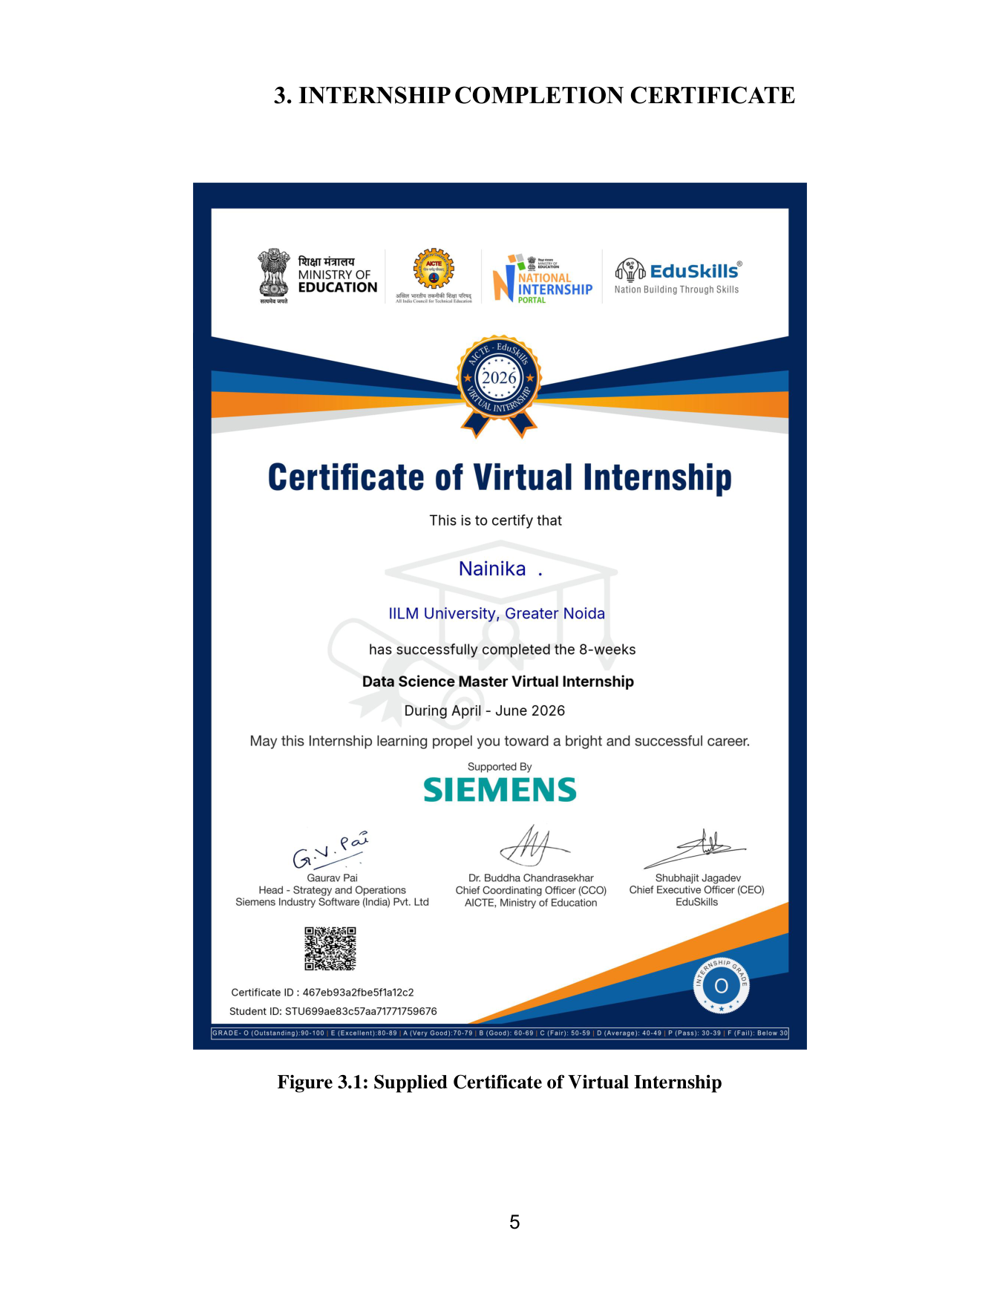
Internship Completion & Supporting Evidence
12
Completion certificate, programme documentation and internship details
Completion Certificate
Official certificate confirming successful completion of the 8-week Data Science Master Virtual Internship during April–June 2026.
Internship Documentation
The report includes the official internship offer letter and completion communication as supporting programme evidence.
O
O GRADE
Academic performance achievement during the internship programme.
Data Science Master Virtual Internship | Nainika
IILM University, Greater Noida

Slide 13
Conclusion
The internship provided a complete and practical view of data science from data access to deployment.
Integrated learning across data engineering, machine learning, applications and platform administration.
Strengthened understanding of real-world analytical workflows, from data preparation to model development and deployment.
Built a strong foundation for future learning in automation, AI integration and production-oriented data science.
Thank You
Questions & Discussion
NAINIKA | B.Tech CSE | IILM University, Greater Noida

